Slide 1





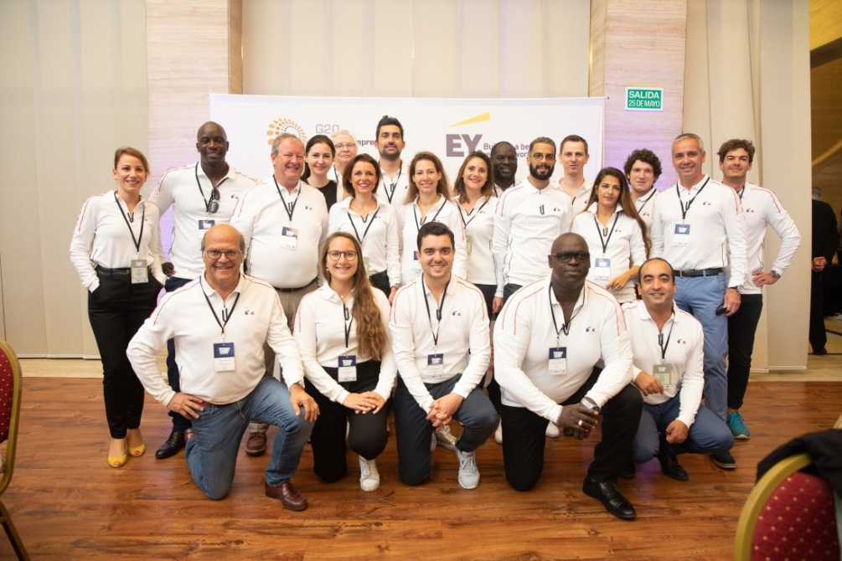
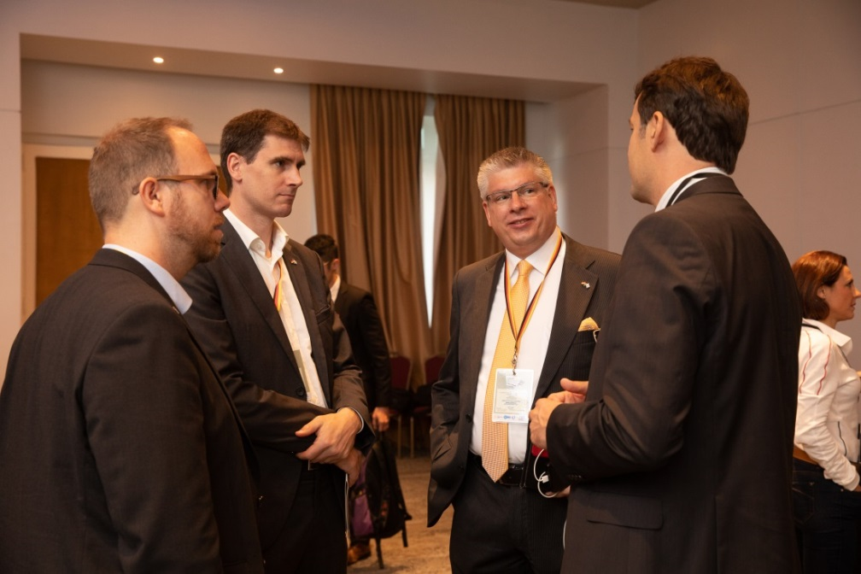


Slide 2




STARTUP
PROGRAMS
ACCELERATION
PROGRAMS
MENTORING
PROGRAMS
SCALEUP
PROGRAMS
EDUCATIONAL
PROGRAMS
ECOSYSTEM
PROGRAMS

Slide 3




